Slide 1
Noise Classification &
Reduction

Slide 2

Introduction
A audio when get mixed with noise, then project model perform classification for which noise it has in background.
Also remove that noise from our audio and clean it .

Slide 3
Earlier we discussed
Earlier we have seen about general brief introduction about spectrogram and CNN . We have implemented till spectrogram of different audios .
The idea was to isolate the mixed audios and classify them as different audio labels.

Slide 4
Move Further

Slide 5
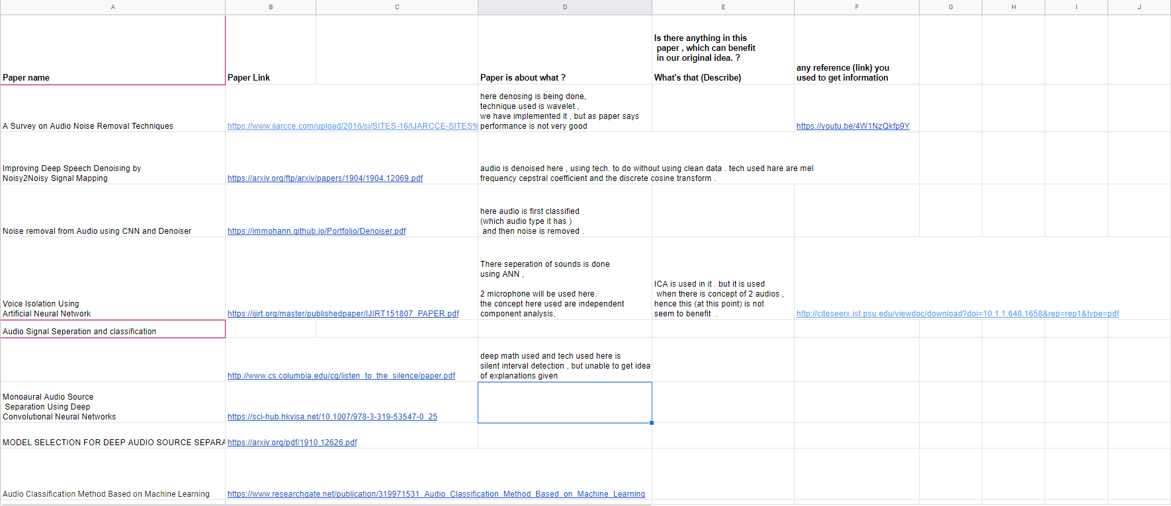
Work in record
LINK
https://docs.google.com/spreadsheets/d/1FdwztRxEDLPqqKUhr_wYD6Hpo5AZ3bjPnc5n8Z7WPlE/edit#gid=0

Slide 6
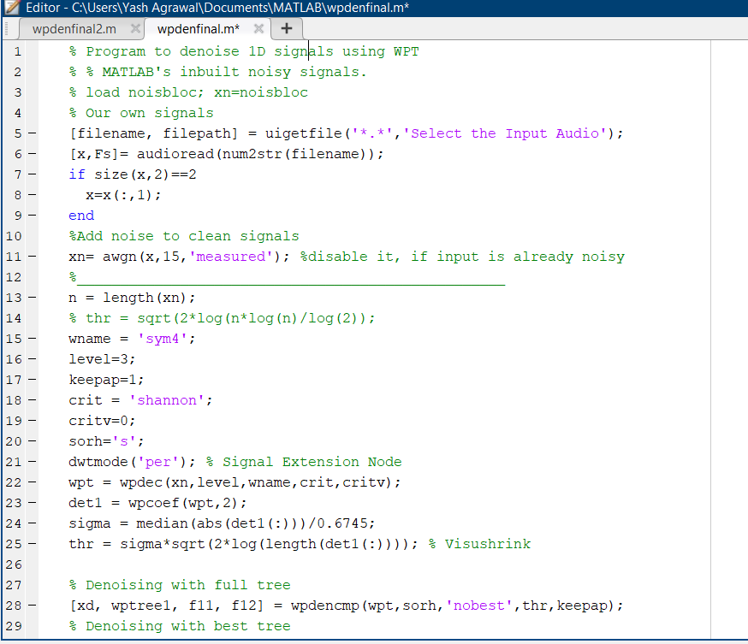
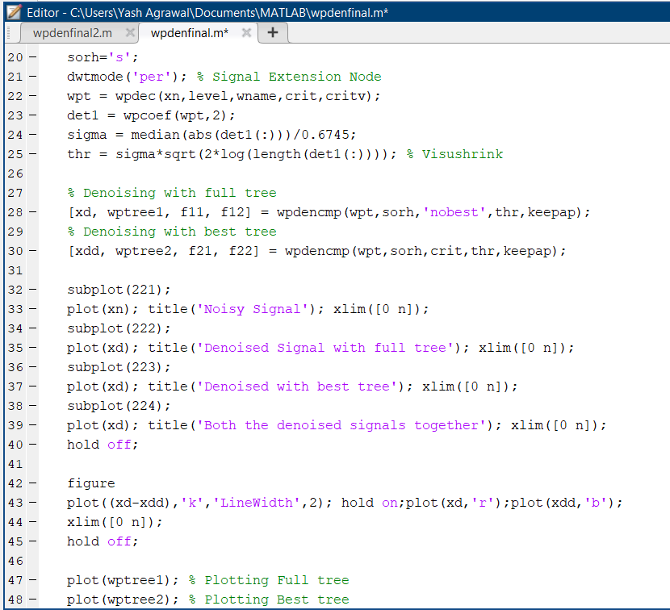
Denoising by Matlab

Slide 7
Inference of Previous Slide
This model was able to denoise the noise for only few audio samples.
It means our accuracy becomes less. So we move on.

Slide 8
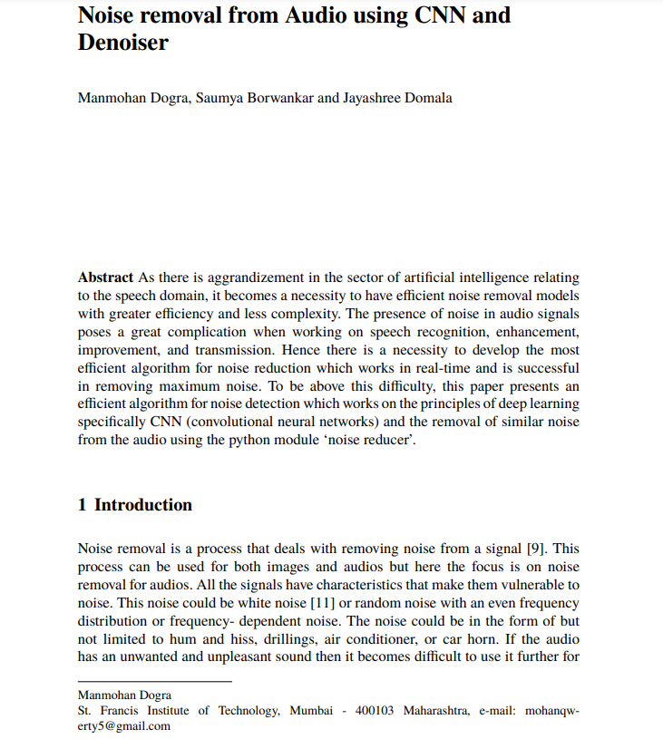
Our Paper

Slide 9
IMPLEMENTATION

Slide 10
About Dataset:
Our dataset contains 8732 Audio Files of different labels
Air conditioner
Car Horn
Children Playing
Dog Bark
Drilling
Engine
Gun Shot
Jackhammer
Siren
Street Music.
LINK :- https://urbansounddataset.weebly.com/urbansound8k.html

Slide 11

2. FEATURES
MFCC (Mel-frequency cepstral coefficients )
Here coefficients to be fed to the model are taken. Here waveform are transformed to get information about frequency part also . then logarithmic of it. Later inversion is done to get coefficients.
LINK -: https://rb.gy/fa1lle
2. Mel spectrogram
Conversion of the spectrogram y-axis (frequency) to a log scale and the color dimension (amplitude) to decibels to form the mel spectrogram.
3. Croma and stft
On croma to get feature, stft is applied.
4. Croma and CQT
Here difference is to use contrast Q transform.
5. Croma and CENS
Cens is croma energy normalised

Slide 12

3. CNN
CNN is used to reduce dimensions of the data matrix which is quite helpful in further operations.

Slide 13
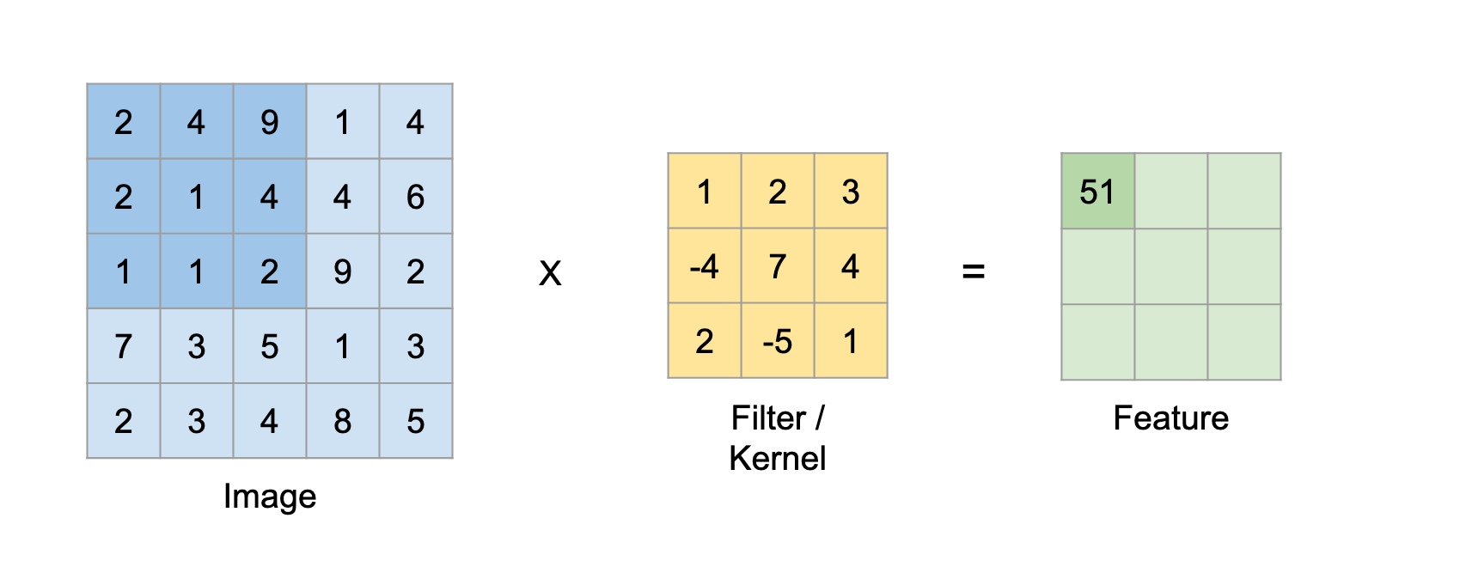
Conv 2D Layer
Conv2D is a 2D Convolution Layer, this layer creates a convolution kernel that is wind with layers input which helps produce a tensor of outputs.
A filter can be of any depth, if a filter is having a depth d it can go to a depth of d layers and convolute i.e sum all the (weights x inputs) of d layer

Slide 14
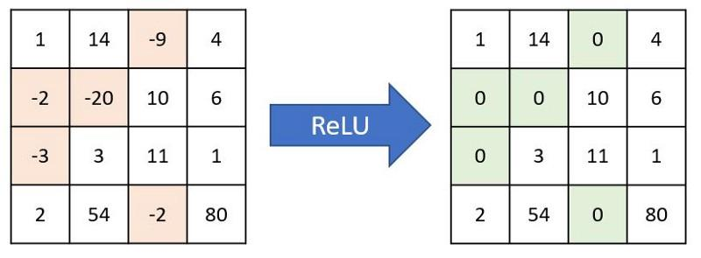
ReLU Layer (Rectified Linear Unit)
A Rectified Linear Unit(ReLU) is a non-linear activation function that performs on multi-layer neural networks. (e.g., f(x) = max(0,x) where x = input value).
A ReLU layer:
performs element-wise operations.
has an output that is a rectified feature map.

Slide 15
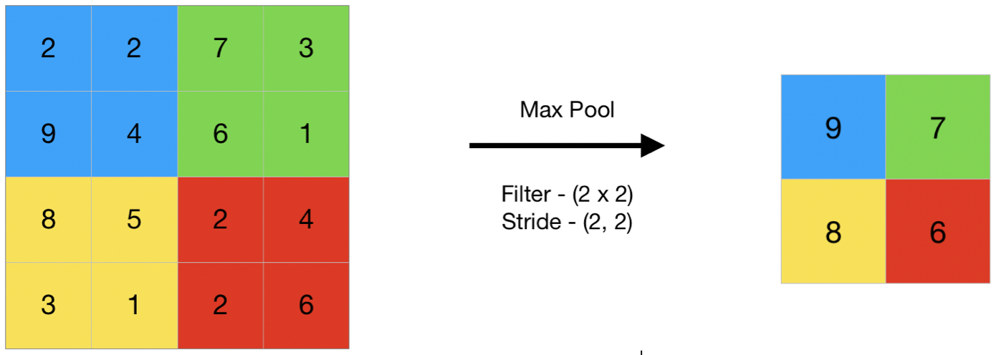
Max Pooling layer
Max Pooling is a convolution process where the Kernel extracts the maximum value of the area it convolves.
Max Pooling simply says to the Convolutional Neural Network that we will carry forward only that information, if that is the largest information available areawise(area of input that kernel covers every time).

Slide 16
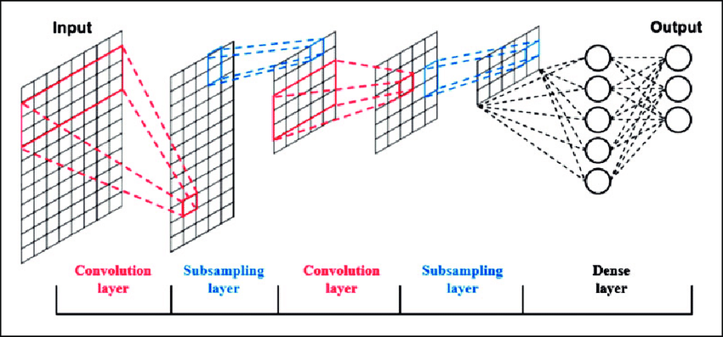
Dense Layer
Dense Layer is simple layer of neurons in which each neuron receives input from all the neurons of previous layer, thus called as dense. Dense Layer is used to classify image based on output from convolutional layers.
Results from every neuron of the preceding layers go to every single neuron of the dense layer.
A Dense layer feeds all outputs from the previous layer to all its neurons, each neuron providing one output to the next layer.

Slide 17
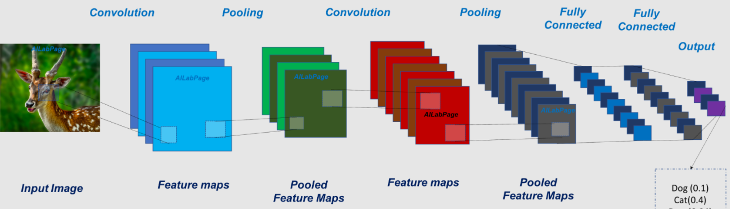
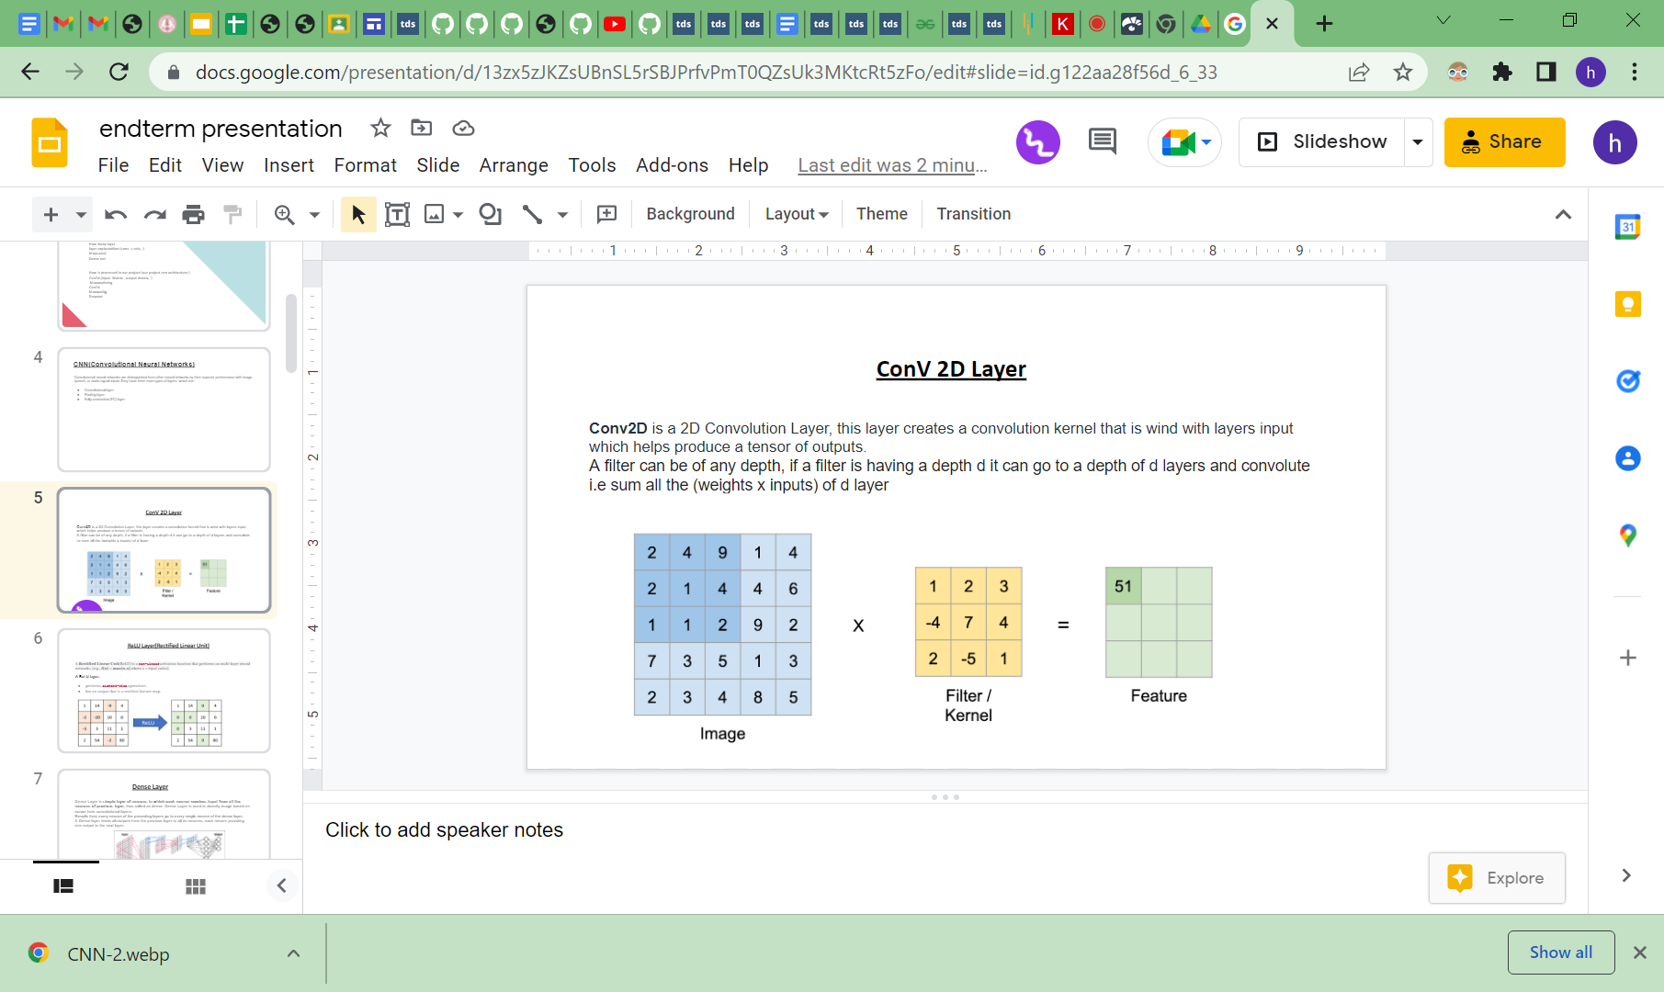
CNN Architecture

Slide 18
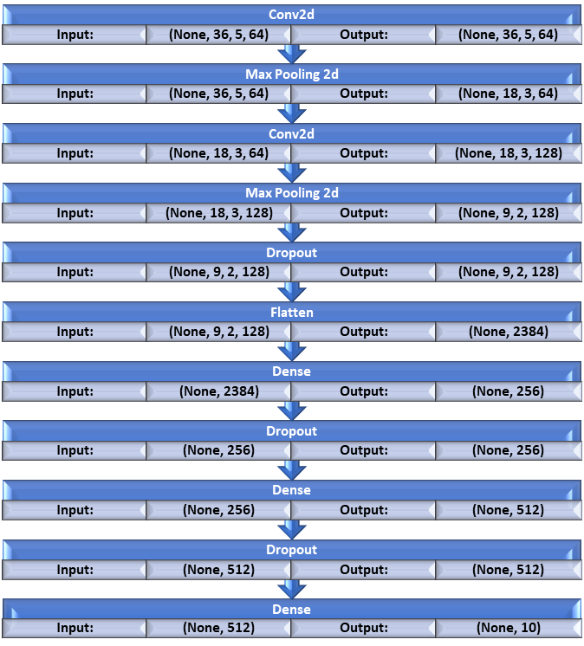

Slide 19
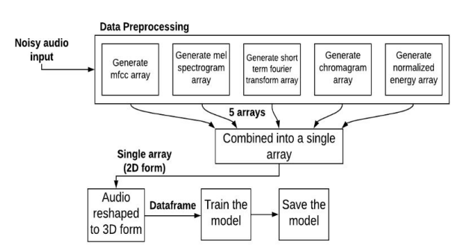
FLOW DIAGRAM OF PRE-PROCESSING
AND TRAINING MODULE

Slide 20
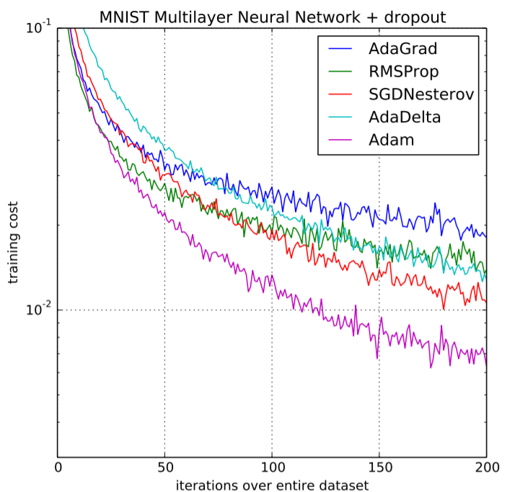
4. Optimizer
Optimizers are algorithms or methods used to change the attributes of the neural network such as weights and learning rate to reduce the losses.
Types of optimizers:
Momentum, Nesterov, Adagrad, Adadelta, RMSProp, Adam and Nadam
Adam is the best optimizers. If one wants to train the neural network in less time and more efficiently than Adam is the optimizer.

Slide 21
Adam Optimizer
Adaptive Moment Estimation is an algorithm for optimization technique for gradient descent.
It is a combination of the ‘gradient descent with momentum’ algorithm and the ‘RMSP’ algorithm.
Momentum:
This algorithm is used to accelerate the gradient descent algorithm by taking into consideration the ‘exponentially weighted average’ of the gradients. Using averages makes the algorithm converge towards the minima in a faster pace.
Root Mean Square Propagation (RMSP):
Root mean square prop or RMSprop is an adaptive learning algorithm that tries to improve AdaGrad. Instead of taking the cumulative sum of squared gradients like in AdaGrad, it takes the ‘exponential moving average’.

Slide 22
Epochs and Batch Size
The batch size is a hyperparameter that defines the number of samples to work through before updating the internal model parameters.
The number of epochs is a hyperparameter that defines the number times that the learning algorithm will work through the entire training dataset.
Trend of batch size and Epochs
If we increase batch size then training accuracy will increase and loss will decrease while same for validation phase and it’s vice versa.
If we increase epoch size then training accuracy will increase and loss will decrease while same for validation phase and it’s vice versa.
In general too many epochs and batch-size may cause model to overfit the training data. It means that model does not learn the data, it memorizes the data. You have to find the accuracy of validation data for each epoch or maybe iteration to investigate whether it over-fits or not

Slide 23
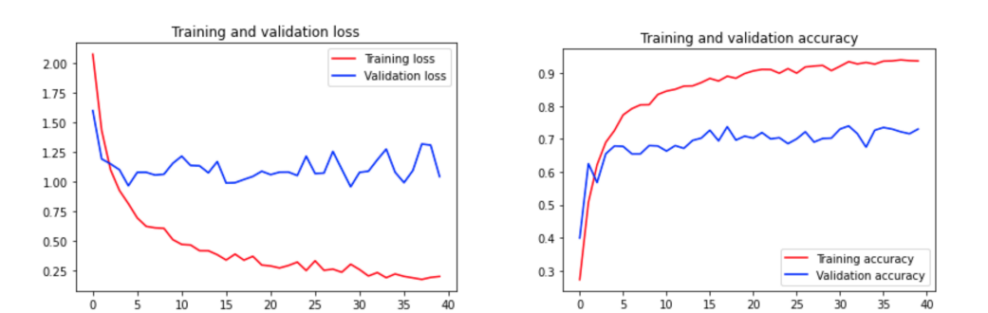

Slide 24
5. Reduce_Noise
Noisereduce is a noise reduction algorithm in python that reduces noise in time-domain signals like speech, bioacoustics, and physiological signals.
It works by computing a spectrogram of a signal (and optionally a noise signal) and estimating a noise threshold (or gate) for each frequency band of that signal/noise.
This threshold is used to compute a mask, which gates noise below the frequency-varying threshold.
The most recent version of noisereduce comprises two algorithms:
Stationary Noise Reduction: Keeps the estimated noise threshold at the same level across the whole signal
Non-stationary Noise Reduction: Continuously updates the estimated noise threshold over time
https://colab.research.google.com/github/timsainb/noisereduce/blob/master/notebooks/1.0-test-noise-reduction.ipynb#scrollTo=_vDS0QWpnjf7

Slide 25
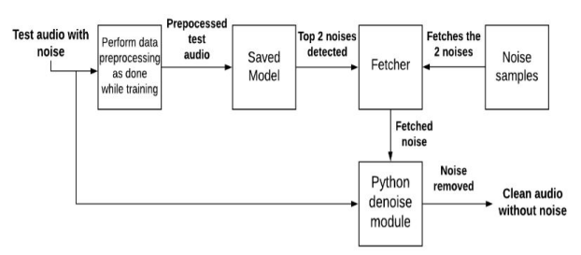
FLOW DIAGRAM
OF THE
NOISE REMOVE MODULE

Slide 26
Future Scope
To move forward to improve this model , make it more robust to provide better results.
To modify model so that it perform great on even indian voices dataset. Hence to prepare indian dataset .
To go for audio isolation ( hence any audios , no needed that to be noise, can be separated).

Slide 27
REFERENCES
https://www.ijarcce.com/upload/2016/si/SITES-16/IJARCCE-SITES%206.pdf
https://arxiv.org/ftp/arxiv/papers/1904/1904.12069.pdf
https://immohann.github.io/Portfolio/Denoiser.pdf
https://ijirt.org/master/publishedpaper/IJIRT151807_PAPER.pdf
http://www.cs.columbia.edu/cg/listen_to_the_silence/paper.pdf
https://sci-hub.hkvisa.net/10.1007/978-3-319-53547-0_25
https://arxiv.org/pdf/1910.12626.pdf
https://www.researchgate.net/publication/319971531_Audio_Classification_Method_Based_on_Machine_Learning
https://github.com/facebookresearch/VisualVoice (visual audio separation)
https://cs230.stanford.edu/projects_fall_2019/reports/26261998.pdf (our main paper)
https://www.simplilearn.com/tutorials/deep-learning-tutorial/convolutional-neural-network (cnn )
https://github.com/jonnor/machinehearing/blob/master/europython2019/presentation.md
https://arxiv.org/pdf/2003.01531.pdf

Slide 28
THANK YOU

